Slide 1
ANNOUNCEMENTS
June 7, 2019

Slide 2

God’s Promise for the week
“The Holy Spirit... will teach you everything
that I told you.”
(Jn 14:26)
Notes:
2

Slide 3

Welcome
Guest

Slide 4

TEACHINGS
Sienna Gift Inventory- LSS 1- 51
ME 47-51 ; SPE 19-21
Prayer Leadership - LSS 1- 48 & Disciplees
Sat., June 15, 2019, 1- 6 pm
@ DMP Classroom

Slide 5
PRAYER HEALING
SEMINAR I
June 22, 2019 - 7am-6pm June 23, 2019 - 7am-5pm Divine Mercy Parish Library, Rahway NJ.
Register online at www. BLDNewark.com
Notes:
All LSS graduates of BLD are invited to participate in this beautiful retreat. After more than 4 years, our community is again offering this moving recollection/seminar.
Limited to 50 participants, please register early.
Email prayer.healing@BLDNewark.com to RSVP, or Register online at www. BLDNewark.com and click on Prayer Healing Seminar I flyer.
There is a registration fee of $50 to cover handouts and food & snacks for both days.

Slide 6
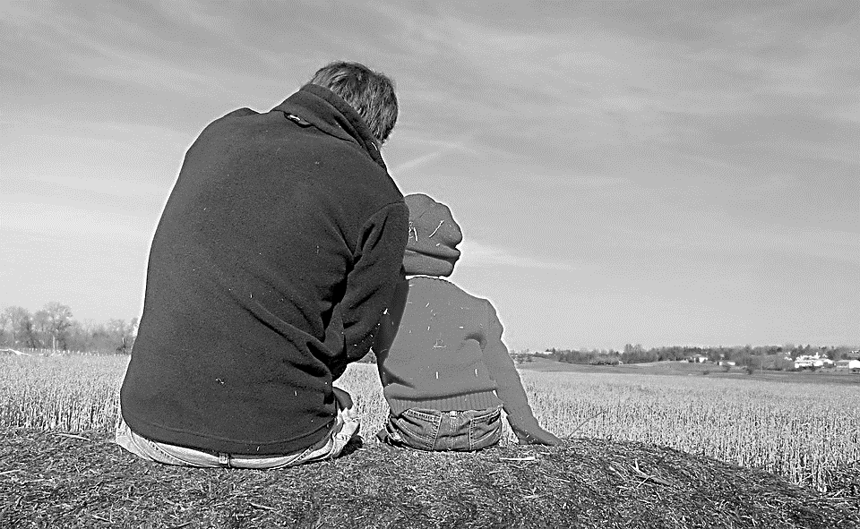
Solo Parents Encounter
Weekend #21
June 29-30, 2019
Days Hotel of East Brunswick
195 NJ 18 East Brunswick, NJ 08816
Please contact: Matt and Precy Yap

Slide 7
Save the Date!
Msgr. Paul Schetelick’s 70th Birthday &
43rd Sacerdotal Anniversary Celebration
July 6, 2019
Eucharistic Celebration at 5:30 pm, Divine Mercy Church, Rahway, NJ
Reception to follow in the DMP Auditorium

Slide 8


YOUTH
ENCOUNTER
#26
July 12 - 14, 2019
Fellowship Deaconry Ministries
3575 Valley Rd, Basking Ridge, NJ 07920
Contact: dyc@bldnewark.com

Slide 9


FAMILY
ENCOUNTER 26
As for me and my household, we will serve the Lord: Joshua 24:15
July 26 -28, 2019
Malvern Retreat House
Malvern PA
Contacts:
Mike and Emma Pepino, Ed and Susan Fabe

Slide 10
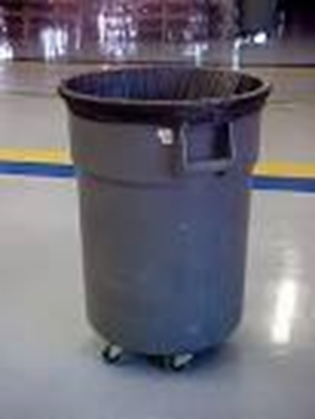
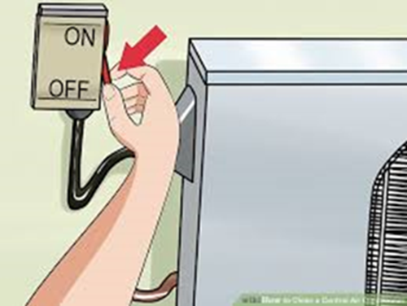
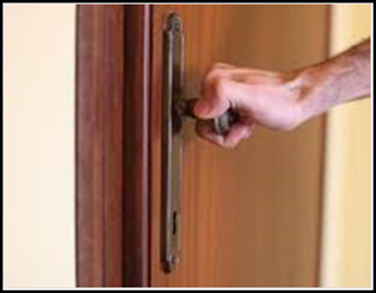
General House Rules
Keep all rooms, including the Gymnasium, Auditorium, Connell Hall & Library, neat and clean. Empty trash bins in the dumpster.
Make sure all the windows & doors are closed, lights and air conditioner/electric fan are turned off, including in the Gym, Auditorium, Connell Hall & Library.
Report issues with any of the building doors, e.g. the door could not be locked or closed, to Vino/Beth Guiang, so that Fr. Alex is notified for security purposes.

Slide 11
Marshaling
Schedule
June 14, 2019
Evangelization
Apostolate

Slide 12
ORDER
“…Receive the
Holy Spirit.”
(Jn 20:22)

Slide 13
DIRECTION
Use the spiritual gifts given you to give glory to the King.

