Slide 1
ANNOUNCEMENTS
Aug. 2, 2019

Slide 2
God’s Promise for the week
“When Christ your life appears, then you too will appear with him in glory.”
Col 3:4
Notes:
2

Slide 3
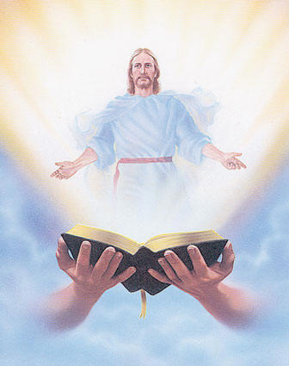
Welcome
Guest

Slide 4
SEPTEMBER 2019 MAGNIFICAT ISSUE
is available for
distribution tonight
at the Auditorium.

Slide 5
Community Day
August 17, 2019
Johnson Park (Piscataway, NJ)
8:30 am – 4:00 pm
11:30 am –Eucharistic Celebration

Slide 6
Family Colors
LAST NAME
(Beginning with)
A – C
D – G
H – P
Q – Z
COLOR
Red
Blue
Green
Yellow

Slide 7
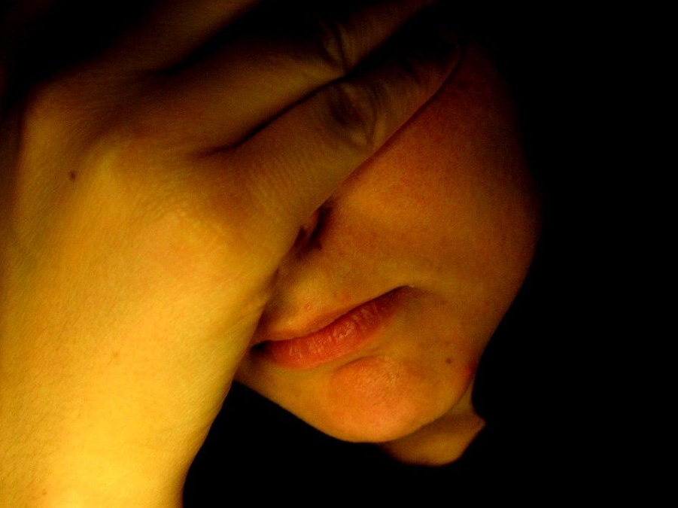
“Breaking
the Silence”
A Symposium on Depression
Led by Msgr. Paul Schetelick
and a Multidisciplinary team.
August 31, 2019 1pm - 6pm, DMP Library
Please RSVP at http://bldnewark.com
Notes:
Youth, Singles and Parents are all invited, Please RSVP at bldnewark.com

Slide 8
BLD NEWARK
2019 Community Fundraising Event
Drawing
Oct. 18, 2019 @ 10:30pm
@ Divine Mercy Parish
1st | 9-Day Trip to the Holy Land for 2 Mar 29-Apr 8, 2020 | $7,000
2nd | 5-Night Cruise to Bermuda for 2 Oct 31-Nov 5, 2020 | $1,264
3rd | Samsung 43” Class 4K UHD LED LCD Smart TV | $280
Other | 10 Consolation Gift Cards of $100 each | $1,000

Slide 9
BLD NEWARK
2019 Community Fundraising Event
Ministry Coordinators / Class Shepherds for the following Ministries / ME Class, please pick up your Raffle Tickets.
FLA
Golden Years
John 6
Liturgy
ME 47
ME 50
ME 51
Medical
Pastoral
Witness Dev.
Youth
Before and after worship, Fundraising Committee Members will be at the back of the auditorium for:
Ticket distribution & Ticket remittance (forms are available),
and to answer any questions.
Remittance forms are available @ www.bldnewark.com

Slide 10
Marshaling
Schedule
August 9, 2019
Pastoral
Apostolate

Slide 11
ORDER
“Seek what is above… not of what is on earth.”
Col 3:1-2

Slide 12
DIRECTIONS
Practice humility and forgiveness in your family, community and workplace.
Share your talent, time and treasure to rebuild and reshape the community.

Slide 13
DIRECTIONS
3. Grow in holiness through prayer, scripture reading and the sacraments.

