Slide 1
ANNOUNCEMENTS
Aug. 9, 2019

Slide 2
God’s Promise for the week
“Blessed are those servants whom the master finds vigilant on his arrival.”
Lk 12:37
Notes:
2

Slide 3
Welcome
Guest

Slide 4
Community Day
August 17, 2019
Johnson Park (Piscataway, NJ)
8:30 am – 4:00 pm
11:30 am –Eucharistic Celebration

Slide 5
Family Colors
LAST NAME
(Beginning with)
A – C
D – G
H – P
Q – Z
COLOR
Red
Blue
Green
Yellow

Slide 6
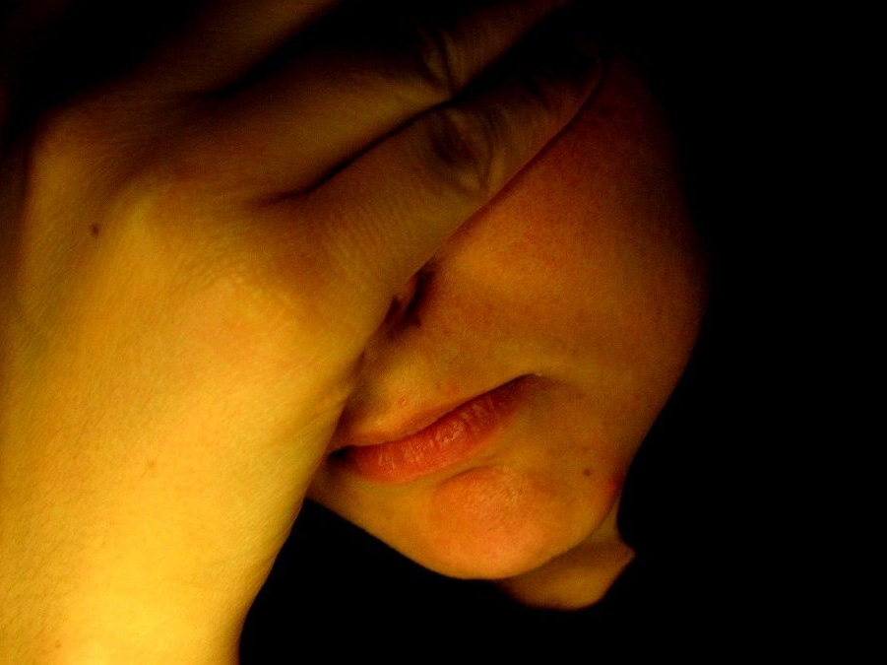
“Breaking
the Silence”
A Symposium on Depression
Led by Msgr. Paul Schetelick
and a Multidisciplinary team.
August 31, 2019 1pm - 6pm, DMP Library
Please RSVP at http://bldnewark.com
Notes:
Youth, Singles and Parents are all invited, Please RSVP at bldnewark.com

Slide 7
BLD NEWARK
2019 Community Fundraising Event
Drawing
Oct. 18, 2019 @ 10:30pm
@ Divine Mercy Parish
1st | 9-Day Trip to the Holy Land for 2 Mar 29-Apr 8, 2020 | $7,000
2nd | 5-Night Cruise to Bermuda for 2 Oct 31-Nov 5, 2020 | $1,264
3rd | Samsung 43” Class 4K UHD LED LCD Smart TV | $280
Other | 10 Consolation Gift Cards of $100 each | $1,000

Slide 8
BLD NEWARK
2019 Community Fundraising Event
Ministry Coordinators / Class Shepherds for the following Ministries / ME Class, please pick up your Raffle Tickets.
FLA
Golden Years
John 6
Liturgy
ME 47
ME 50
ME 51
Medical
Pastoral
Witness Dev.
Youth
Before and after worship, Fundraising Committee Members will be at the back of the auditorium for:
Ticket distribution & Ticket remittance (forms are available),
and to answer any questions.
Remittance forms are available @ www.bldnewark.com

Slide 9
Marshaling
Schedule
August 16, 2019
Evangelization
Apostolate

Slide 10
ORDER
“Be prepared, for at
an hour you do not expect, the Son of
Man will come.”
Lk 12:40

Slide 11
DIRECTIONS
Immerse yourselves in prayers and daily reflection of God’s Word.
Be involved in programs that serve the weak and the needy.

