Slide 1
ANNOUNCEMENTS
Jan. 18, 2019

Slide 2
God’s Promise for the week
“You shall be a glorious crown in the hand of
the LORD...”
Is 62:3
Notes:
2

Slide 3
Welcome
Guest

Slide 4
February 2019 MAGNIFICAT ISSUE
is available for
distribution tonight
at the Auditorium.

Slide 5
TEACHINGS
NCR/GIP – ME 47,49,50 /
SPE 20 / SE 38
CMP II, Part 1 - LSS 1- 48 / ME48
/ SPE 19
Cancelled
Sat., Jan. 19, 2019, 1- 6 pm
@ DMP Classroom
Notes:
Due to inclement weather, teachings for tomorrow is cancelled.

Slide 6
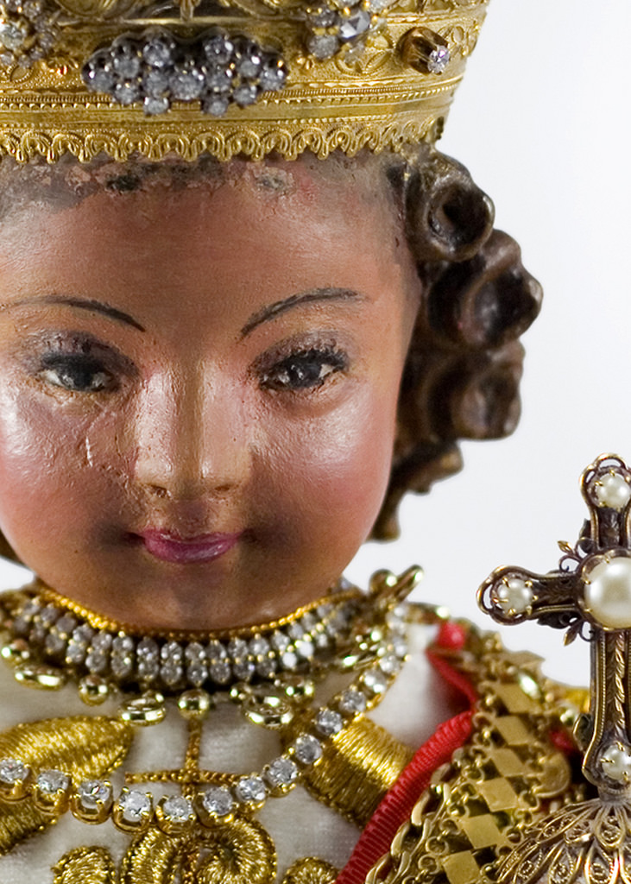
Divine Mercy Parish
Invites you
FEAST
OF
STO. NIÑO
January 20, 2019
Notes:
Fr Alex and Fr Robert Lamirez is inviting the BLD community on the Feast of Sto Nino celebration at Divine Mercy Parish, Rahway NJ on Sunday, January 20. Please see church bulletin for details.

Slide 7
2000 Hail Mary’s for the Medical Mission –
Saturday,
January 26, 8 am to 5 pm,
@DMP Rm 204

Slide 8
Marshaling
Schedule
Jan. 25, 2019
Management
Apostolate

Slide 9
ORDER
"… Do whatever
he tells you."
Jn 2:5

Slide 10
DIRECTIONS
Exercise your spiritual gifts to build up the community.
Always pray for the guidance of the Holy Spirit when discerning the will of God.
Be faithful to our covenantal pledges.

Slide 11
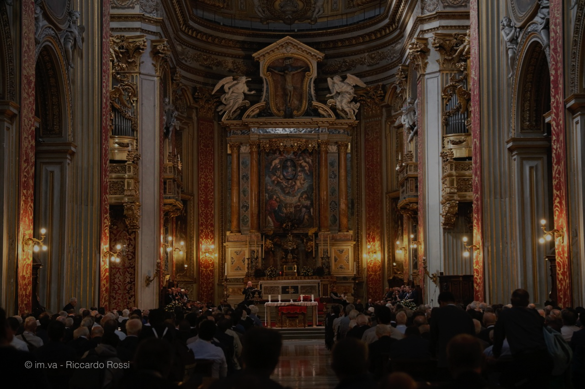
Please maintain REVERENCE
at all times while
we are still in the
House of God.

