Slide 1
ANNOUNCEMENTS
Jan. 17, 2020

Slide 2
God’s Promise for the week
“…I will make you a light
to the nations...”
Is 49:6b
Notes:
2

Slide 3
Welcome
Guest

Slide 4
February 2020 MAGNIFICAT ISSUE
is available for
distribution tonight
at the Auditorium.

Slide 5
TEACHINGS
New Creation Realities
Growth in Prayer
Encounter with Jesus
Understanding Corporate Worship
Prayer Leadership
Sat., Jan 18, 2020, 1- 6 pm
@ DMP Classroom

Slide 6
FRIDAY, JANUARY 24, 2020
Washington DC
Contact:
Ray Salmo at RayCSalmo@gmail.com or any Mission Apostolate member
Bus leaves DMP parking lot at 6:30 AM
Notes:
Those who would like to signup as volunteer marchers during the March for Life, please contact Ray Salmo at RayCSalmo@gmail.com, or any member of the Mission Apostolate.
The bus for marchers will be leaving DMP parking at 6:30 AM on Jan 24, 2020 (Friday).

Slide 7
BLD “Singles Family” Reunion
Saturday, Feb 8, 2020
10 am to 6 pm,
@DMP Auditorium
Email: single.family@bldnewark.com

Slide 8
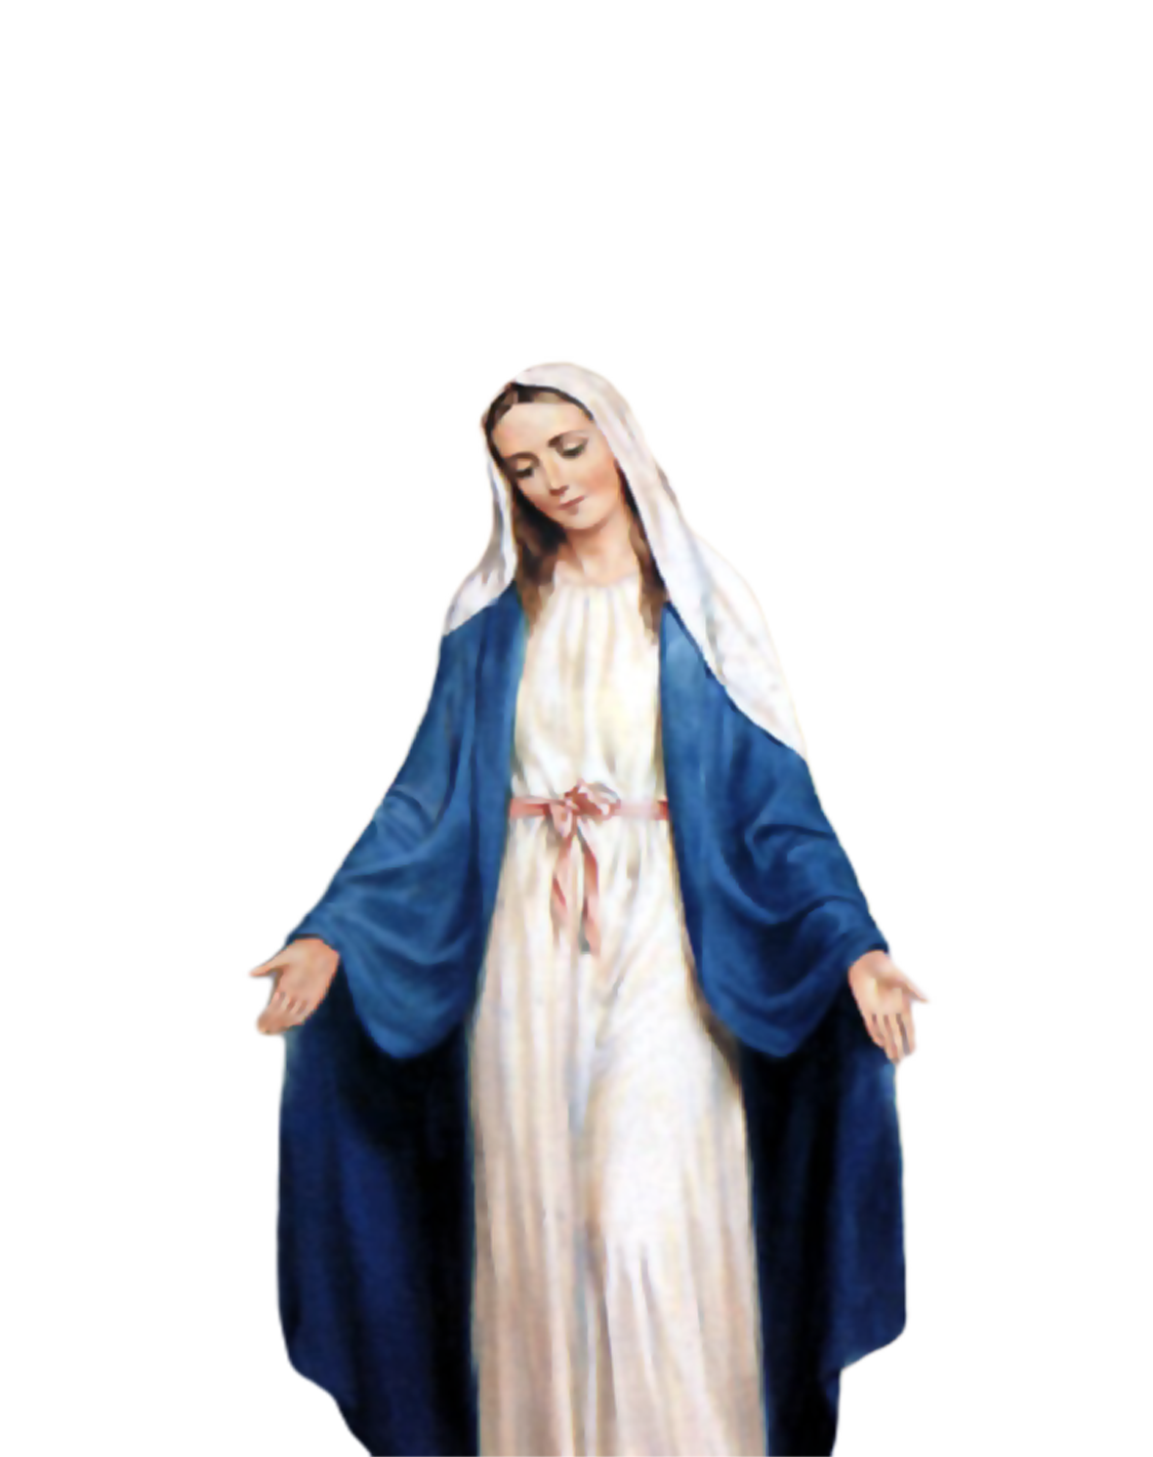
Medical Mission 2020
Jordan, Guimaras, Philippines
February 10 to 13, 2020
2000 Hail Mary’s for the Medical Mission
Saturday, January 25, 2020
at the DMP Library

Slide 9
Marshaling
Schedule
Jan. 24, 2020
Pastoral
Apostolate

Slide 10
ORDER
“...be my servant...”
Is 49:6a

Slide 11
DIRECTION
Bear witness to the love
of Christ by caring for the weak and needy with all humility.

