Slide 1
ANNOUNCEMENTS
Jan. 24, 2020

Slide 2
God’s Promise for the week
“…I shall see the bounty
of the Lord in the land
of the living.”
Ps 27:13
Notes:
2

Slide 3
Welcome
Guest

Slide 4
BLD “Singles Family” Reunion
Saturday, Feb 8, 2020
10 am to 6 pm,
@DMP Auditorium
Email: single.family@bldnewark.com

Slide 5
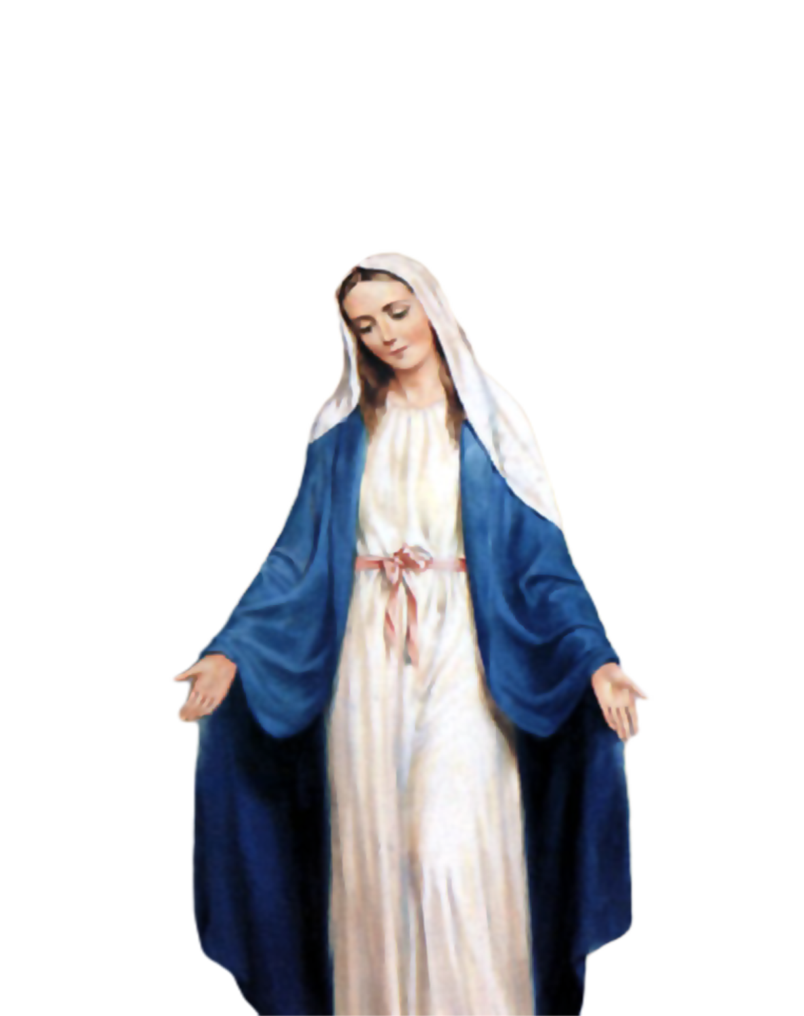
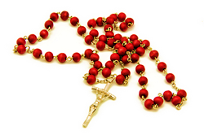
Medical Mission 2020
Jordan, Guimaras, Philippines
February 10 to 13, 2020
2000 Hail Mary’s for the Medical Mission
Saturday, January 25, 2020
at the DMP Library

Slide 6
Protecting God's Children (PGC)
March 14, 2020
9:00 am
@ DMP Library
Please arrive 10 minutes earlier
Register with location BLD (Rahway) at https://www.virtus.org

Slide 7
Life in the
Spirit
Seminar #51
March 28-29, 2019
Salubungan is on Feb. 28, 2020
Contacts: lsa@bldnewark.com
Fil.Flores@bldnewark.com
Online registration is available at BLDNewark.com
BLD Newark

Slide 8
Marshaling
Schedule
Jan. 31, 2020
Management
Apostolate

Slide 9
ORDER
“...be united in the same mind and in the same purpose.”
1 Cor 1:10b

Slide 10
DIRECTION
Serve harmoniously
and share the joy of
your new life
in Christ.

