Slide 1
ANNOUNCEMENTS
July 5, 2019

Slide 2
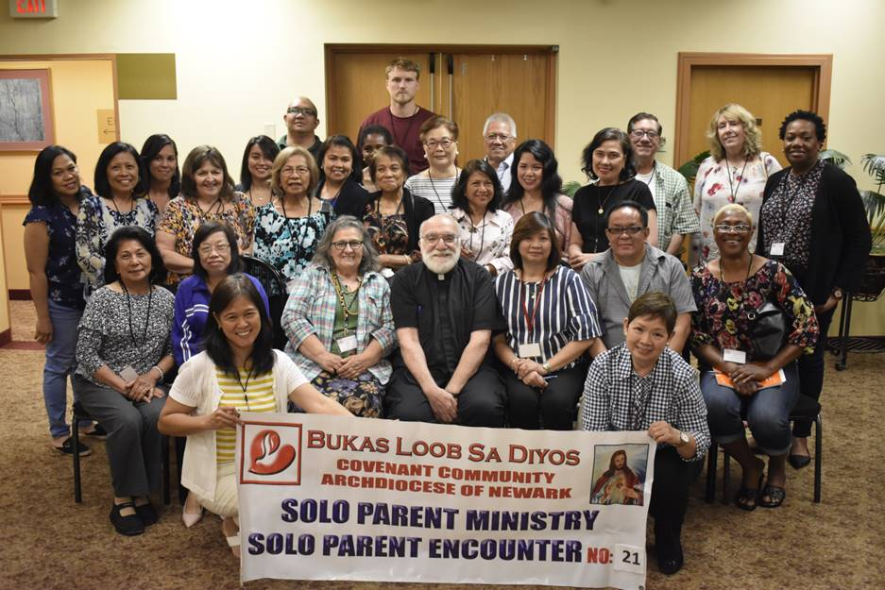
Welcome SPE 21

Slide 3

God’s Promise for the week
“…rejoice because
your names are
written in heaven.”
Lk 10:20b
Notes:
3

Slide 4

Welcome
Guest

Slide 5
Msgr. Paul Schetelick’s 70th Birthday &
43rd Sacerdotal Anniversary Celebration
July 6, 2019
Eucharistic Celebration at 5:30 pm, Divine Mercy Church, Rahway, NJ
Reception to follow in the DMP Auditorium
Notes:
Please visit bldnewark.com to RSVP

Slide 6
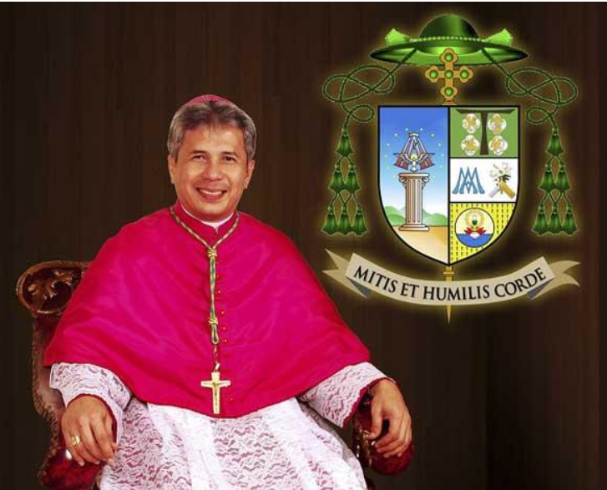
RSVP for Invitation to
Bishop Reynaldo G. Evangelista
First U.S. Pastoral Visit
July 13, 2019 Saturday, 12pm
to 8:30 pm @DMP
Visit bldnewark.com
to RSVP and details
Notes:
'Please register/ RSVP for Bishop Rey's Pastoral visit celebration at the Secretariat Mini Cyber station at the auditorium tonight. The deadline for last registration is July 5, 2019. Kindly register so you will be counted and your names listed at the front desk".

Slide 7
The celebration will be held on Saturday, July 13, 2019 at the Divine Mercy Parish
(DMP) grounds in Rahway, NJ.
- Registration opens at 12:00 noon.
- Plenary Session Proper begins at 1:00 pm and culminates in a Eucharistic
Celebration and Fellowship through 8:30 pm.
- Light refreshments and then dinner will be served.
- Please note: No parking in the inside DMP lots before 5:00 pm but parking is
available at nearby Zion Lutheran Church (entry at driveway located on 215 Elm Avenue, Rahway, NJ (at the corner of Elm and Esterbrook Avenues).
- Suggested Color theme attire - tops/shirts
Newark: Red
Trenton: White
Long Island: Blue
Washington DC: Yellow
- When you register - kindly include your BLD District and your Ministry and/or
Apostolate in the BLD District Affiliation field.
- Please RSVP by July 5, 2019
- Contacts: Jovy Lucero (jovy.lucero@bldnewark.com) / Gale De Leon (gale.de.leon@bldnewark.com)

Slide 8


YOUTH
ENCOUNTER
#26
July 12 - 14, 2019
Fellowship Deaconry Ministries
3575 Valley Rd, Basking Ridge, NJ 07920
Contact: dyc@bldnewark.com

Slide 9
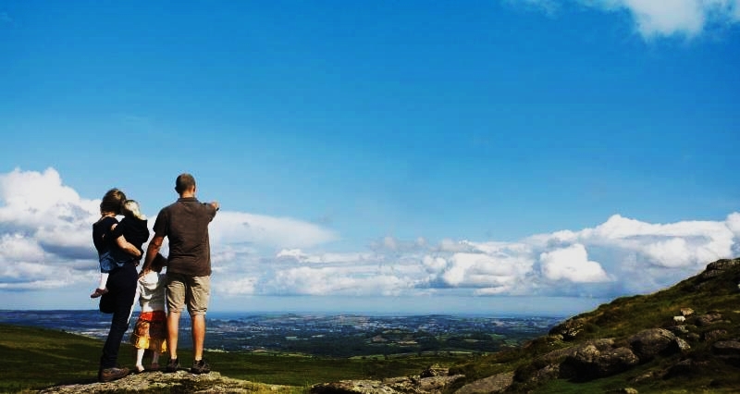

FAMILY
ENCOUNTER 26
As for me and my household, we will serve the Lord: Joshua 24:15
July 26 -28, 2019
Malvern Retreat House
Malvern PA
Contacts:
Mike and Emma Pepino, Ed and Susan Fabe

Slide 10
Community Day
August 17, 2019
Johnson Park (Piscataway, NJ)
8:30 am – 4:00 pm
11:30 am –Eucharistic Celebration

Slide 11
Family Colors
LAST NAME
(Beginning with)
A – C
D – G
H – P
Q – Z
COLOR
Red
Blue
Green
Yellow

Slide 12
Marshaling
Schedule
July 12, 2019
Evangelization
Apostolate

Slide 13
ORDER
“Come and see the works of God…”
Ps 66:5

Slide 14
DIRECTIONS
Be a living witness of God’s transforming love and power by the way you think, speak and act.
Show your concern for others through caring words and generosity.

