Slide 1
ANNOUNCEMENTS
March 22, 2019

Slide 2
God’s Promise for the week
“He redeems your life
from destruction, he
crowns you with kindness and compassion.”
(Ps 103:4)
Notes:
2

Slide 3
Welcome
Guest

Slide 4
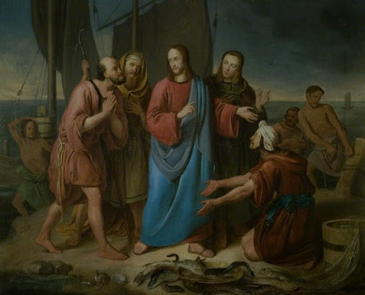
DISCIPLES’
ASSEMBLY
Saturday, March 30, 2019
@ DMP Auditorium

Slide 5
Life in the
Spirit
Seminar #51
April 5-7, 2019
Contacts: Earl & Flo Manguiat
bldnewarklsa@gmail.com
BLD Newark

Slide 6
Notes:
Please register online at bldnewark.com

Slide 7
Marriage Encounter
Weekend 52
18th -19th of May 2019
Sacred Heart Center, Newton, New Jersey
I hold you in my heart, for we have shared together God’s blessing.
Philippians 1:7
Please contact mla@bldnewark.com
BLD Newark

Slide 8
Marshaling
Schedule
March 29, 2019
Formation
Apostolate

Slide 9
ORDER
“…repent.”
Lk 13:3

Slide 10
DIRECTION
Be reconciled with God by receiving the Sacrament of Reconciliation.

