Slide 1
ANNOUNCEMENTS
March 29, 2019

Slide 2
God’s Promise for the week
“Whoever is in Christ is a new creation.”
2Cor 5:17a
Notes:
2

Slide 3
Welcome
Guest

Slide 4
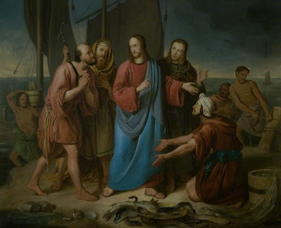
DISCIPLES’
ASSEMBLY
Sat, Mar. 30, 2019, 12- 4pm
@ DMP Auditorium

Slide 5
Life in the
Spirit
Seminar #51
April 5-7, 2019
Contacts: Earl & Flo Manguiat
bldnewarklsa@gmail.com
BLD Newark

Slide 6
Notes:
Please register online at bldnewark.com

Slide 7
Marriage Encounter
Weekend 52
18th -19th of May 2019
Sacred Heart Center, Newton, New Jersey
I hold you in my heart, for we have shared together God’s blessing.
Philippians 1:7
Please contact mla@bldnewark.com
BLD Newark

Slide 8
Marshaling
Schedule
April 5, 2019
Management
Apostolate

Slide 9
ORDER
“…be reconciled to God.”
2 Cor 5:20b

Slide 10
DIRECTIONS
Make amends with the Lord through the Sacraments and living a life that is pleasing to Him.
Reconcile your differences with your brethren.

