Slide 1
ANNOUNCEMENTS
May 10, 2019

Slide 2

God’s Promise for the week
“The Lamb...will shepherd
them and lead them to
springs of life-giving water.”
Rev 7:17a
Notes:
2

Slide 3

Welcome
Guest

Slide 4
June 2019
MAGNIFICAT ISSUE
is available for
distribution tonight
at the Auditorium.

Slide 5


Marriage Encounter
Weekend 52
18th -19th of May 2019
Sacred Heart Center, Newton, New Jersey
I hold you in my heart, for we have shared together God’s blessing.
Philippians 1:7
Please contact mla@bldnewark.com
BLD Newark

Slide 6


Slide 7
PRAYER HEALING
SEMINAR I
June 22, 2019 - 7am-6pm June 23, 2019 - 7am-5pm Divine Mercy Parish Library, Rahway NJ.
Register online at www. BLDNewark.com
Notes:
All LSS graduates of BLD are invited to participate in this beautiful retreat. After more than 4 years, our community is again offering this moving recollection/seminar.
Limited to 50 participants, please register early.
Email prayer.healing@BLDNewark.com to RSVP, or Register online at www. BLDNewark.com and click on Prayer Healing Seminar I flyer.
There is a registration fee of $50 to cover handouts and food & snacks for both days.

Slide 8
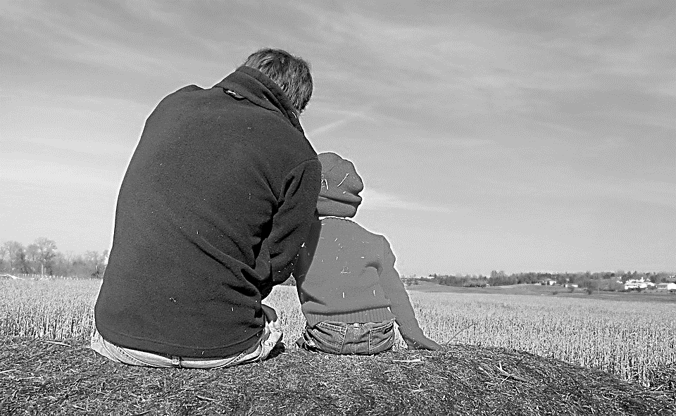
Solo Parents Encounter
Weekend #21
June 29-30, 2019
Days Hotel of East Brunswick
195 NJ 18 East Brunswick, NJ 08816
Please contact: Matt and Precy Yap

Slide 9

YOUTH
ENCOUNTER
#26
July 12 - 14, 2019
Fellowship Deaconry Ministries
3575 Valley Rd, Basking Ridge, NJ 07920
Contact: dyc@bldnewark.com

Slide 10
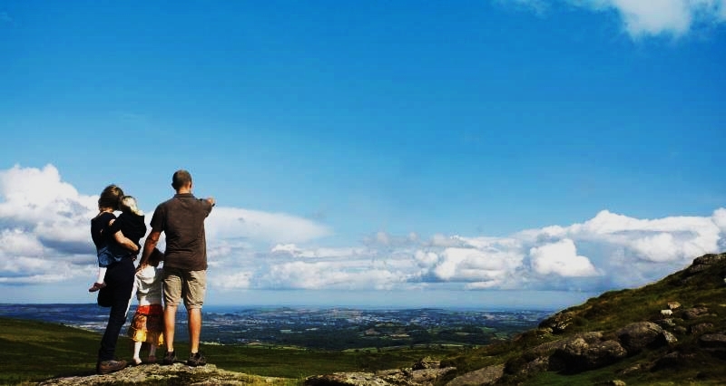

FAMILY
ENCOUNTER 26
As for me and my household, we will serve the Lord: Joshua 24:15
July 26 -28, 2019
Malvern Retreat House
Malvern PA
Contacts:
Mike and Emma Pepino, Ed and Susan Fabe

Slide 11
Marshaling
Schedule
May 17, 2019
Management
Apostolate

Slide 12
ORDER
“...be an instrument
of salvation to the
ends of the earth.”
Acts 13:47b

Slide 13
DIRECTIONS
Actively invite others to our encounters and seminars.
Exercise pastoral care to everyone.

