Slide 1
ANNOUNCEMENTS
May 31, 2019

Slide 2

God’s Promise for the week
“…those who are called may receive the promised eternal inheritance.”
Heb 9:15b
Notes:
2

Slide 3

Welcome
Guest

Slide 4

Notes:
Deadline to register is June 6th.
Venue: Sacred Heart Retreat Center
20 Old Swartswood Road Newton NJ 07860

Slide 5
PRAYER HEALING
SEMINAR I
June 22, 2019 - 7am-6pm June 23, 2019 - 7am-5pm Divine Mercy Parish Library, Rahway NJ.
Register online at www. BLDNewark.com
Notes:
All LSS graduates of BLD are invited to participate in this beautiful retreat. After more than 4 years, our community is again offering this moving recollection/seminar.
Limited to 50 participants, please register early.
Email prayer.healing@BLDNewark.com to RSVP, or Register online at www. BLDNewark.com and click on Prayer Healing Seminar I flyer.
There is a registration fee of $50 to cover handouts and food & snacks for both days.

Slide 6
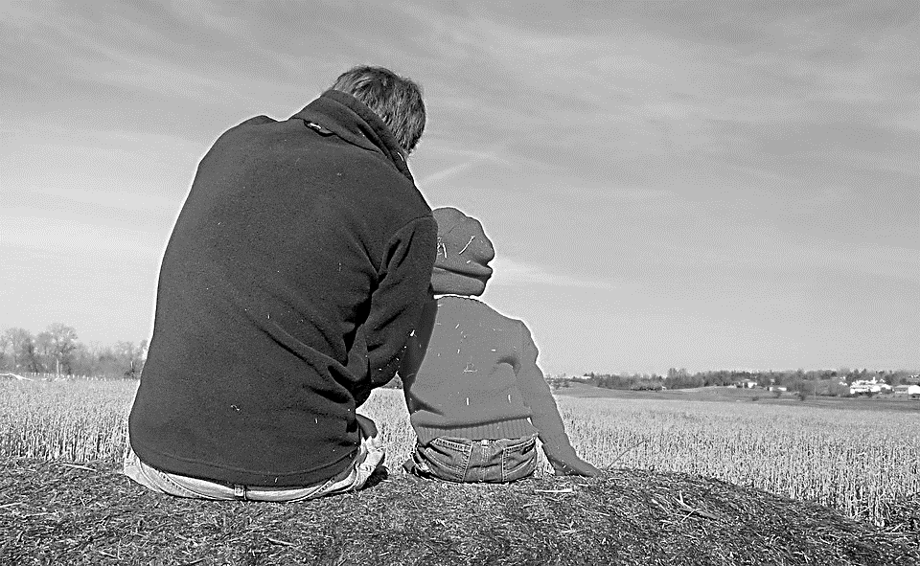
Solo Parents Encounter
Weekend #21
June 29-30, 2019
Days Hotel of East Brunswick
195 NJ 18 East Brunswick, NJ 08816
Please contact: Matt and Precy Yap

Slide 7
Save the Date!
Msgr. Paul Schetelick’s 70th Birthday &
43rd Sacerdotal Anniversary Celebration
July 6, 2019
Eucharistic Celebration at 5:30 pm, Divine Mercy Church, Rahway, NJ
Reception to follow in the DMP Auditorium

Slide 8


YOUTH
ENCOUNTER
#26
July 12 - 14, 2019
Fellowship Deaconry Ministries
3575 Valley Rd, Basking Ridge, NJ 07920
Contact: dyc@bldnewark.com

Slide 9


FAMILY
ENCOUNTER 26
As for me and my household, we will serve the Lord: Joshua 24:15
July 26 -28, 2019
Malvern Retreat House
Malvern PA
Contacts:
Mike and Emma Pepino, Ed and Susan Fabe

Slide 10
Marshaling
Schedule
June 7, 2019
Evangelization
Apostolate

Slide 11
ORDER
“Take it; this is my body…this is my blood of the covenant.”
Mk 14:22b,24

Slide 12
DIRECTION
Live out the meaning of the Eucharist by serving Christ through acts of charity.

