Slide 1
ANNOUNCEMENTS
Nov. 15, 2019

Slide 2
God’s Promise for the week
“By your perseverance you will secure your lives.”
Lk 21:19
Notes:
2

Slide 3
Welcome
Guest

Slide 4
TEACHINGS
Apologetics II – ME 48 / SPE 19
Encounter with Jesus – ME 47 / ME 49 / ME 50
Basic Bible Seminar – ME 51 & 52 / SPE 19 / SE 39
Gifts & Fruits of the Holy Spirit – SPE 20
Sat., Nov. 16, 2019, 1- 6 pm
@ DMP Classroom

Slide 5
Prayer Healing
Seminar II
Nov. 23 - 24, 2019 7 am – 6 pm
2nd floor Library,
Divine Mercy Parish, Rahway, NJ
REQUIREMENT: MUST HAVE ALREADY ATTENDED PRAYER HEALING SEMINAR I
Email prayer.healing@BLDNewark.com to RSVP, or
Register online at www. BLDNewark.com and click on
Prayer Healing Seminar II flyer
Notes:
All graduates of Prayer Healing Seminar 1 are invited to participate in the second part of this 2-part seminar /retreat.
During our fellowship in the Auditorium, there's an informational table for Prayer Healing Seminar II. Please stop by and obtain details regarding registration for this beautiful weekend to journey into the heart with Jesus the Healer.
Email prayer.healing@BLDNewark.com to RSVP, or Register online at www. BLDNewark.com and click on Prayer Healing Seminar II flyer

Slide 6
ME #53
Grand Reunion
Dec. 7, 2019
12 pm – 5pm
Divine Mercy Parish Library

Slide 7
FRIDAY, JANUARY 24, 2020
Washington DC

Slide 8
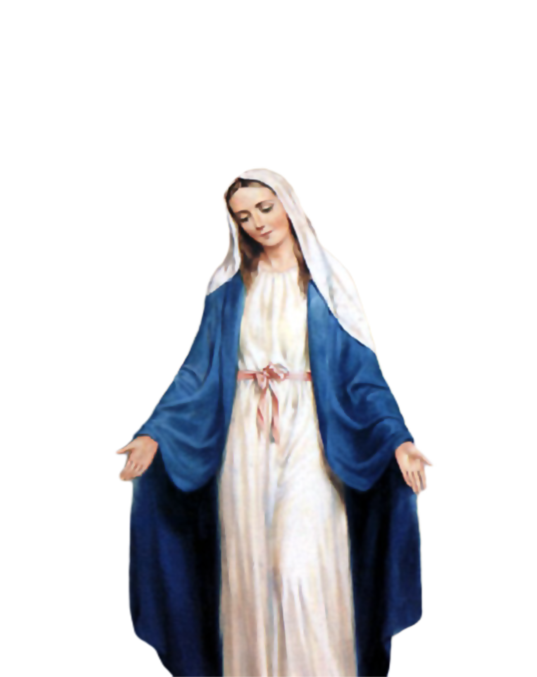
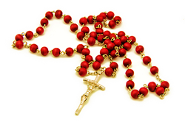
Medical Mission 2020
Jordan, Guimaras, Philippines
February 10 to 13, 2020
2000 Hail Mary’s for the Medical Mission
Saturday, January 25, 2020
at the DMP Library

Slide 9
Marshaling
Schedule
Nov. 22, 2019
Pastoral
Apostolate

Slide 10
ORDER
“...See that you not be deceived, for many will come in my name...Do not follow them.”
Lk 21:8

Slide 11
DIRECTIONS
1. Do not conform to the ways of the world.
2. Keep busy, stay focused on doing your ministry work.

