Slide 1
ANNOUNCEMENTS
Sept. 27, 2019

Slide 2
God’s Promise for the week
“Blessed is he who keeps faith
forever, secures justice for the oppressed, gives food to the hungry. The Lord sets captives free.”
Ps 146:7
Notes:
2

Slide 3
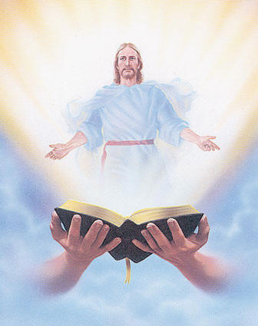
Welcome
Guest

Slide 4
Life in the
Spirit
Seminar #52
October. 4 - 6, 2019
Contacts: Earl & Flo Manguiat
bldnewarklsa@gmail.com
BLD Newark
Notes:
Online registration is available at bldnewark.com website

Slide 5
Crossing #20
“…let the children come to me…”
October 4 - 6, 2019
Fellowship Deaconry Ministries ​3575 Valley Road
Liberty Corner, NJ 07938

Slide 6
What is God's plan in
our married life?
October 26-27 2019
Marriage Encounter #53
Sacred Heart Center, 20 Old Swartswood Road Newton, NJ
Visit BLDnewark.com to register

Slide 7
BLD NEWARK
2019 Community Fundraising Event
Drawing
Oct. 18, 2019 @ 10:30pm
@ Divine Mercy Parish
1st | 9-Day Trip to the Holy Land for 2 Mar 29-Apr 8, 2020 | $7,000
2nd | 5-Night Cruise to Bermuda for 2 Oct 31-Nov 5, 2020 | $1,264
3rd | Samsung 43” Class 4K UHD LED LCD Smart TV | $280
Other | 10 Consolation Gift Cards of $100 each | $1,000

Slide 8
BLD NEWARK
2019 Community Fundraising Event
Fundraising Committee Members will be at the back of the auditorium before & after worship,
to collect ticket and remittance form with payments, and to answer any questions.
Remittance forms are available @ www.bldnewark.com
Notes:
Here is the most recent progress report from the Fundraising Committee. Approximately 28.16% of 100% or 704 of 2,500 booklets were remitted and payments collected. That is, $14,080 of our $50,000 goal, we have less than 4 weeks. We encourage all members to remit sold tickets on Fridays, before or after worship, so our fundraising progress may be properly monitored and reported. Please return the unsold tickets so they can be redistributed. DO NOT sit on unsold tickets, that will hurt our Fundraising effort! Please give the community a chance to raise the much-needed funds for all our community endeavors. Let us all strive to do our personal best, so our community may continue to fund all our works of mercy.

Slide 9
2020 Magnificats Renewal
Deadline: Oct 11, 2019
Please submit orders and payments per Ministry/or M.E. class to Marc / Emma.
Notes:
Starting next month, September 6, we will be accepting orders for the 2020 Magnificat. Rates are the same:
English (regular print) - $22.00
Spanish - $19.95
Magnifikids - $12.30
Large Print - $39.95
Deadline for submitting orders per ministry/ME will be OCTOBER 11.
We will not be accepting orders AFTER THE DEADLINE (OCTOBER 11).
You can either pay by check (payable to BLD Newark) or cash.

Slide 10
?
?
If you have questions
?
e-Giving
BLD
email
Photo ID
password reset
BLD Secretariat
Available tonight at the auditorium

Slide 11
Marshaling
Schedule
Oct. 4, 2019
Management
Apostolate

Slide 12
ORDER
“…Pursue righteousness, devotion, faith, love, patience, and gentleness.”
1 Tm 6:11

Slide 13
DIRECTION
Perform corporal works of mercy.

